Slide 1



Visionary Catalysters
FROM DATA TO ACTION:
A CLEARER FORECAST
“We’re Visionary Catalysts, and we built a data-driven tool that transforms NASA’s satellite data into clear, actionable air quality forecasts.”

Slide 2

Visionary Catalysters
PREDICTING CLEANER, SAFER SKIES
Our project uses NASA’s Earth observation data to forecast local air quality.
Cloud-based analysis transforms massive datasets into actionable insights.
Designed to help communities anticipate pollution before it happens.
Turning space data into real-world impact for cleaner, safer skies.

Slide 3
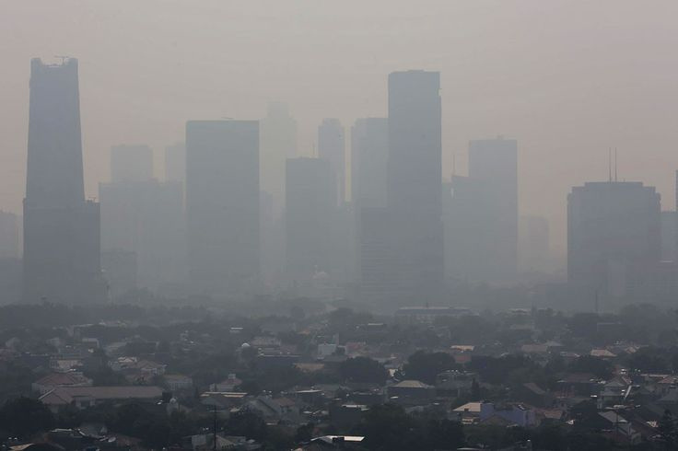
Visionary Catalysters
THE INVISIBLE THREAT
Air pollution is a silent killer affecting billions worldwide every day.
99% of people breathe air exceeding safe quality standards.
Pollutants like NO₂, PM₂.₅, and O₃ cause severe health and climate impacts.
The real danger lies in what we can’t see — unseen data, unseen damage.

Slide 4
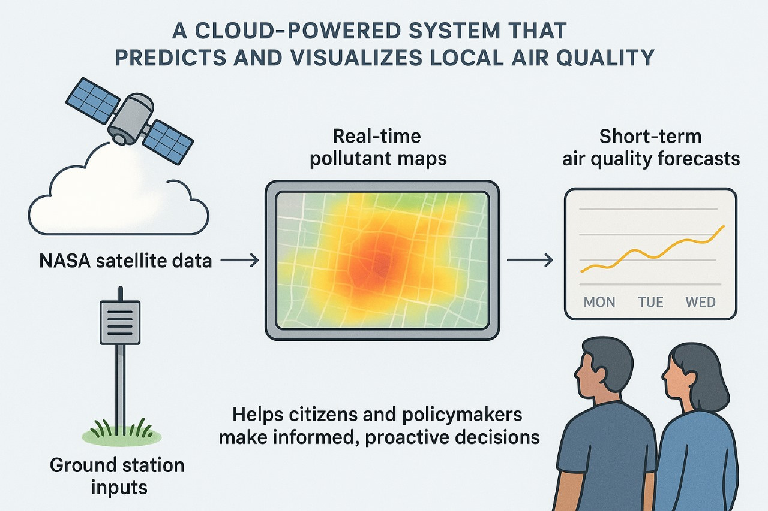
Visionary Catalysters
OUR SOLUTION: A TOOL FOR ACTION
A cloud-powered system that predicts and visualizes local air quality.
Combines NASA satellite data (like TEMPO) with ground station inputs.
Provides real-time pollutant maps and short-term air quality forecasts.
Helps citizens and policymakers make informed, proactive decisions.

Slide 5
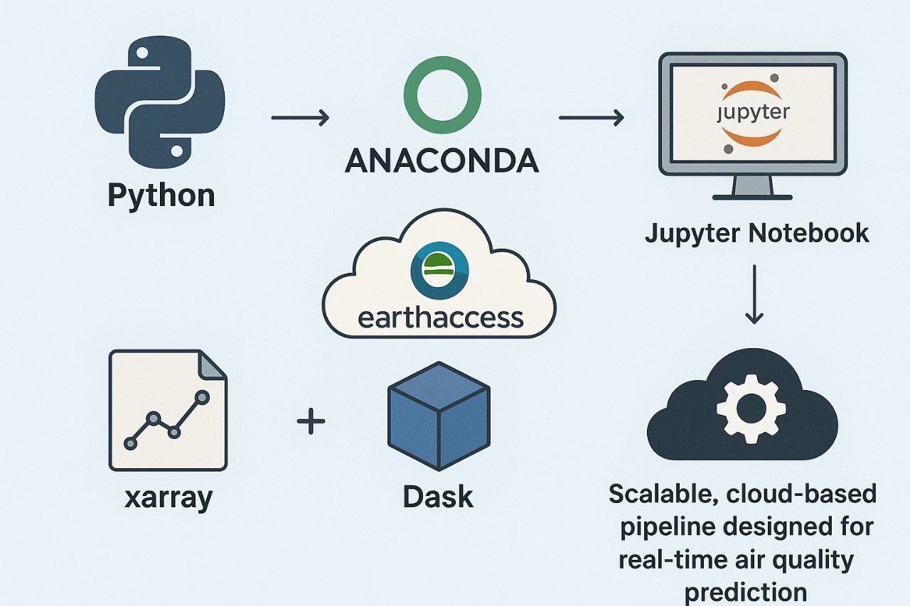
Visionary Catalysters
THE TECHNOLOGY:OUR ENGINE
Built using Python, Anaconda, and Jupyter Notebook for data analysis.
earthaccess connects directly to NASA’s EarthData for seamless retrieval.
xarray and Dask process large NetCDF datasets efficiently in the cloud.
Scalable, cloud-based pipeline designed for real-time air quality prediction.

Slide 6
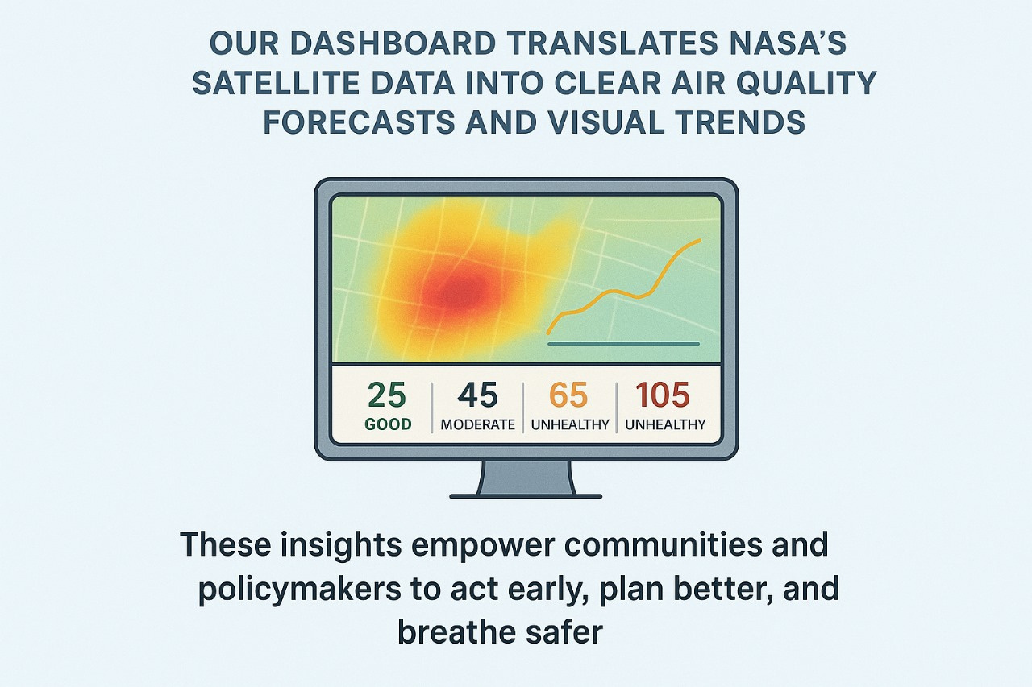
Visionary Catalysters
THE FORECAST IS CLEAR : THE IMPACT IS REAL
Our dashboard translates NASA’s satellite data into clear air quality forecasts and visual trends.
These insights empower communities and policymakers to act early, plan better, and breathe safer.
By making invisible pollution visible, we drive awareness, prevention, and data-backed local action.
Our system converts complex Earth observation data into easy-to-understand air quality predictions.

Slide 7

Visionary Catalysters
OUR VISION: A BREATH OF FRESH AIR
By collaborating with environmental organizations and agencies, we seek to promote open data usage, public awareness, and collective climate action for cleaner skies.
We aim to scale our model into a global, AI-powered air quality monitoring network that provides hyperlocal predictions for every community.

